Slide 1
DGMD-599
An Open Source Wi-Fi Based Device Detection System
Mike Vartanian

Slide 2




Elevator Pitch
Objective: Create a system that counts devices (or people) within physical locations
Motivation:
Consumer behavior information is very valuable to physical location owners
Learn more about CakePHP, Ajax, DBs, Python, etc…

Slide 3

So How Will it Work?
Assumptions
Most people have WiFi Enabled Smartphones
Devices always looking for connections
Operation Principles
Emulate an Access Point
Devices share information when attempting to connect
MAC Address is a unique identifier

Slide 4


















What does the solution look like?
Web Application
Access Point
Pull Data from Aps and Store in NoSQL DB
Access Point
Access Point

Slide 5
A few definitions before we begin…
Location – represents a physical place
Access Point – represents the scanning device
Floorplan Library – represents the collection of floor plans
AP Zone – connects locations with access points
Heatmap – connects floor plans with access points
Scan Results – all results from WiFi scanner
Unique Devices – unique device results over a given time period
RSSI – Received Signal Strength Indicator

Slide 6
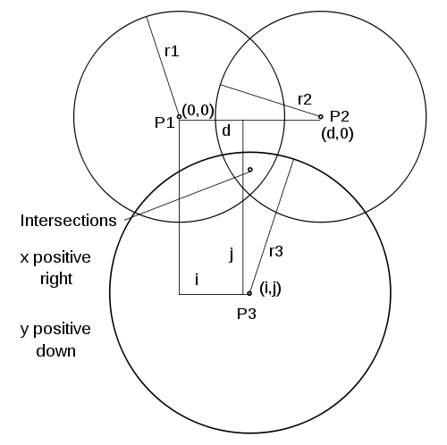
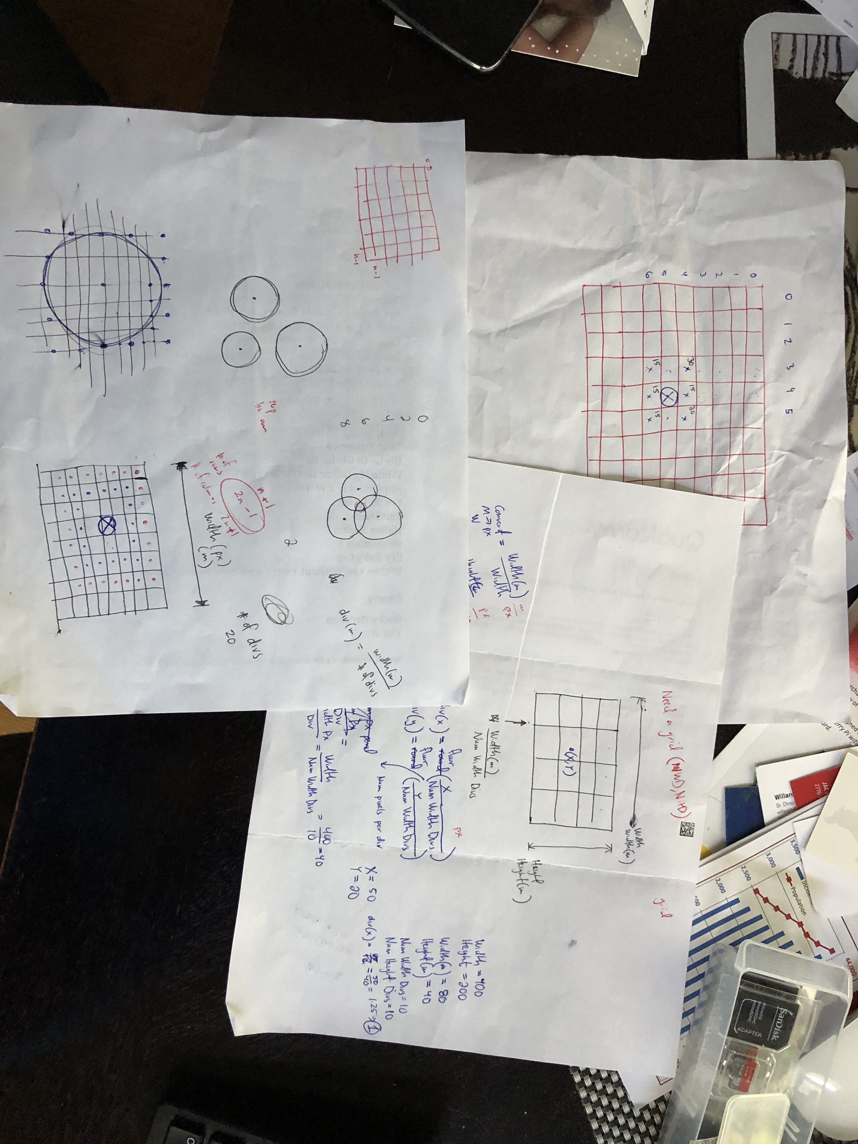
Oh and one more term…
Trilateration – the process of determining absolute or relative locations of points by measurement of distances, using the geometry of circles, spheres or triangles.
Very difficult to do trilateration in real-time:
We don’t always have enough source data points
Measured distances inaccurate
Needed to Approximate!

Slide 7
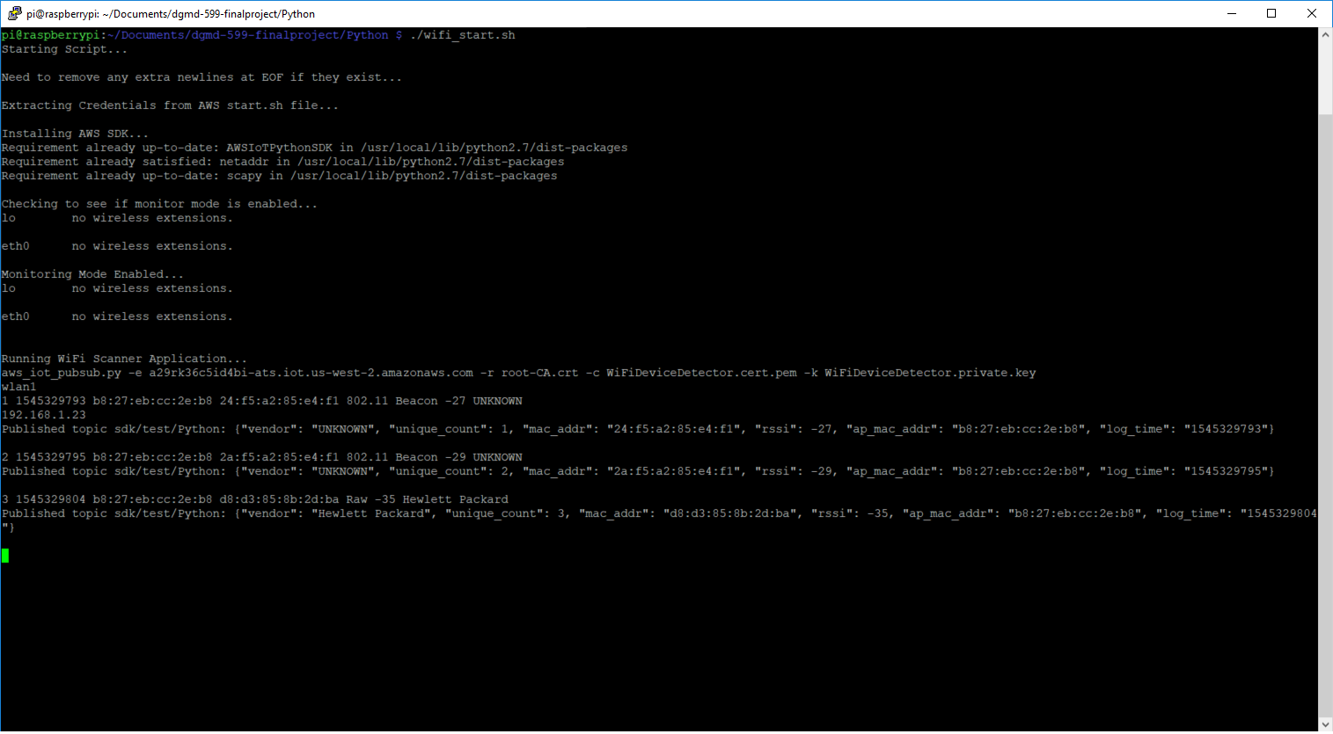
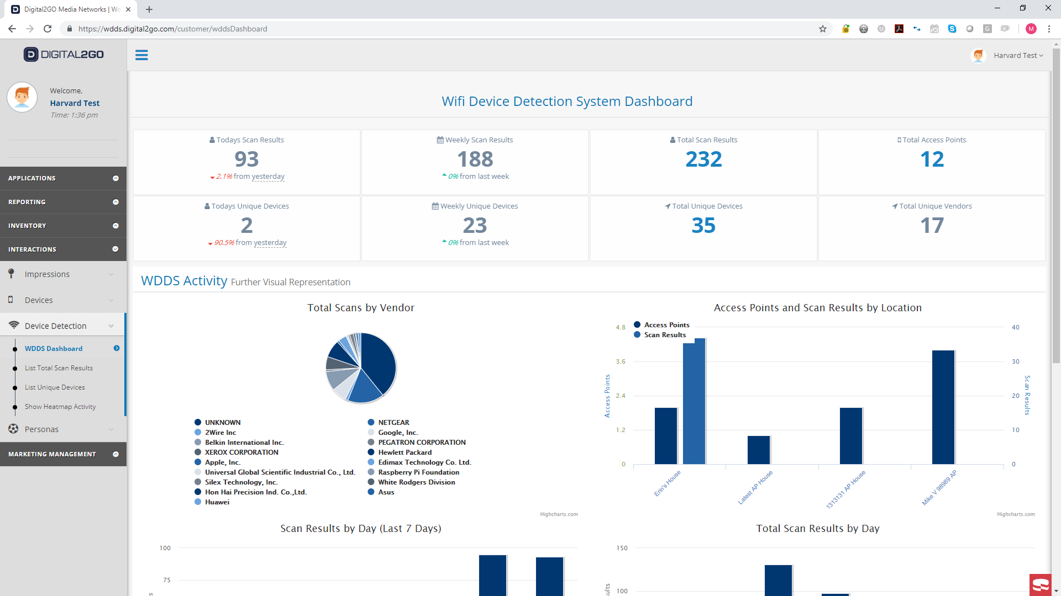
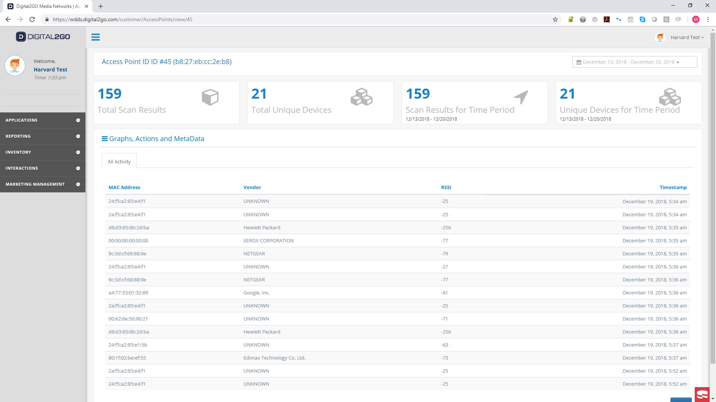
Let’s try to demonstrate the system…

Slide 8
So what worked… And what didn’t…
Successes
Challenges
Embedded WiFi Device Scanner
AWS IoT / DynamoDB Integration
Relational vs Non-Relational DBs
No machine learning
Time/data
Integrate into existing codebase
Differences in Device WiFi
iOS WiFi Obfuscation

Slide 9
Future
Implement Machine Learning Module
Add time based feature to heatmaps
Clean up CSS
Integrate into live platform
Offer as separate product for company

Slide 10
www.locally.io
Questions?

